Slide 1
Creating QRProblems Hints

Slide 2
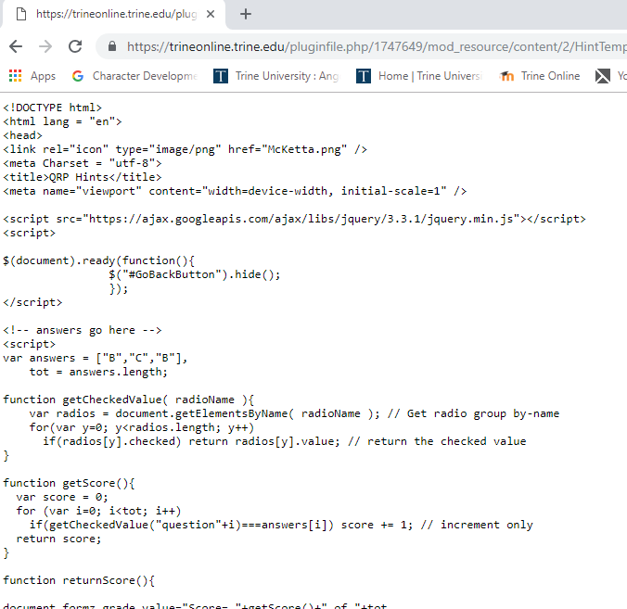
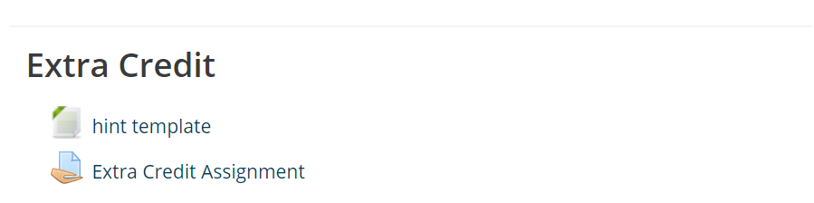
1st – Copy and Paste the Template
Click anywhere in the document
Ctrl A to select all
Ctrl C to copy
Click on “hint template”

Slide 3
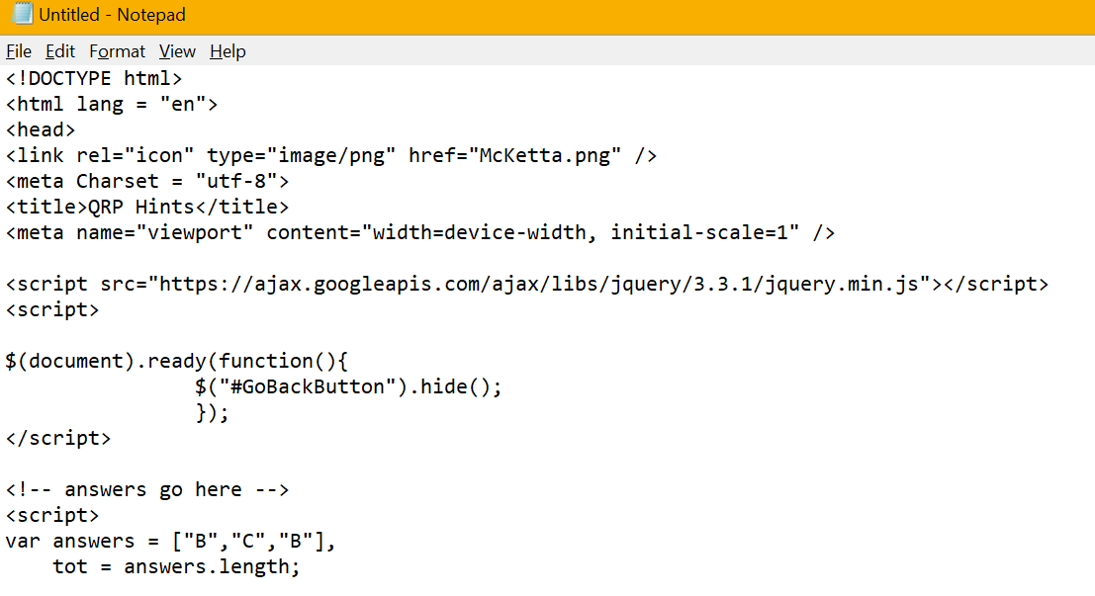
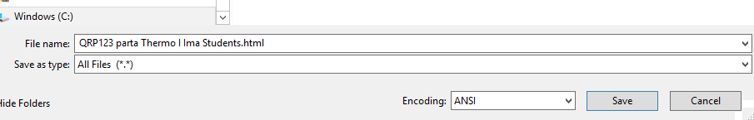
Open a Text Editor – Notepad
Ctrl V to Paste
1. Save file – Give the file a name - QRPxxx part y Thermo I yourname.html

Slide 4
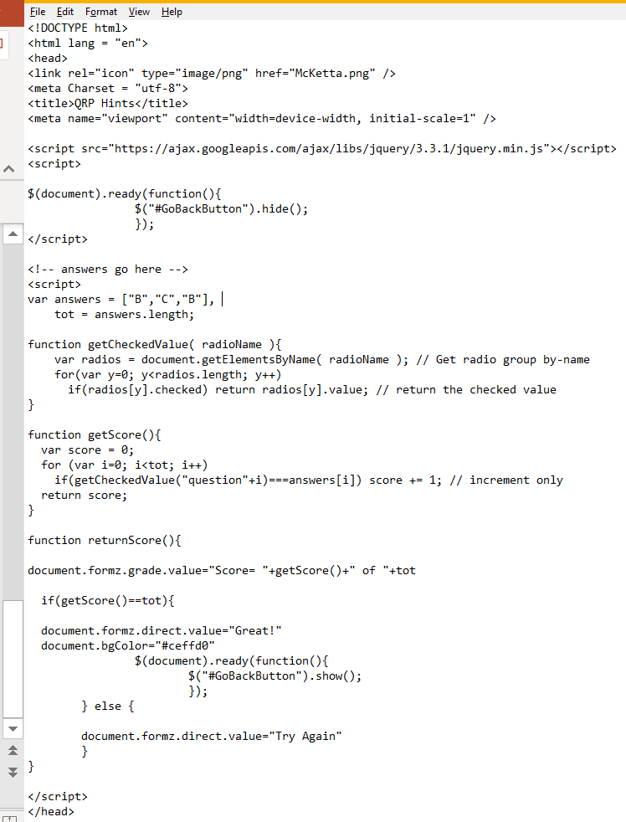
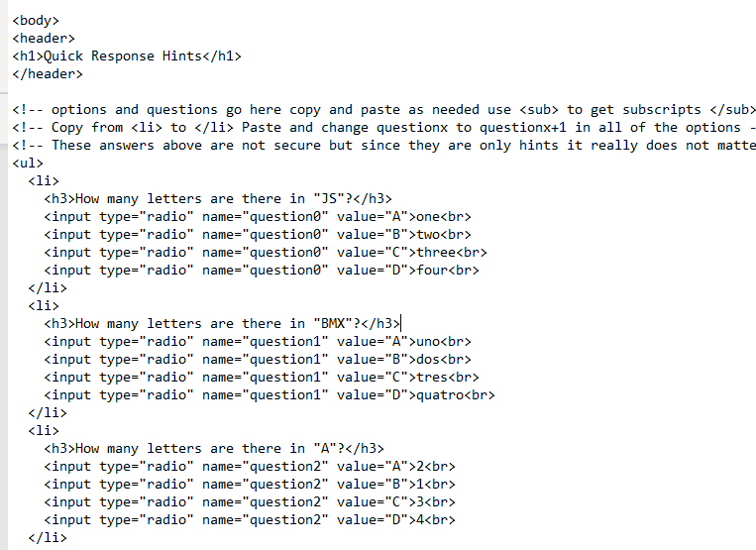
Modify the Document Shown in the highlighted areas

Slide 5
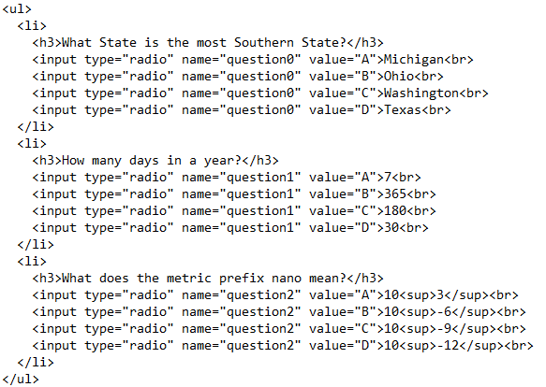

For Example
Notice how to put in superscripts

Slide 6
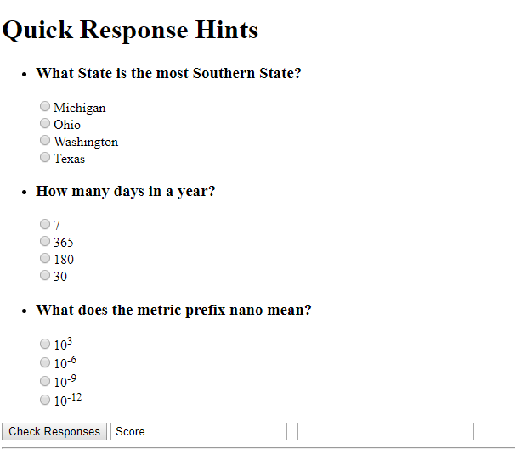
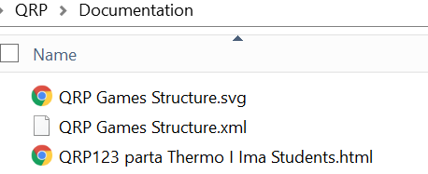
Re-Save the File– then click to open in File Explorer
Double check for errors and see if the question behaves as expected

Slide 7
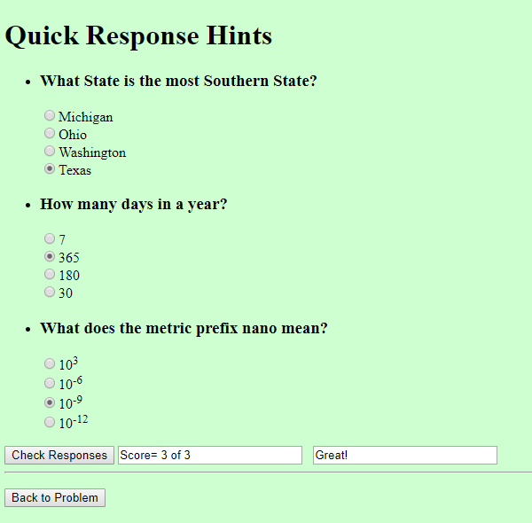
Should look like this - if you get all the answers correct

Slide 8
If you need to re-edit the file
1) right click on the file
2) select open with
3) find notepad again
4) click on it

Slide 9
Upload file to Moodle
I award the equivalent of 2 test points for each problem hint file that is error free and helps the students with common problems that they would have for that problem part.
Each hint file should contain 3 to 5 – single answer 4-part multiple choice questions that directly pertain to the problems that students might have

Slide 10
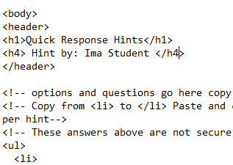
Other notes
I use Notepad++ instead of Notepad
Notepad++ is not built into windows but is a free download
It has more features such as line numbers, color coding and spell checker and also allows you to test the file while still in the editor
If you would like your name to appear with the hint just add the following line:

Slide 11
That’s it _ Good Luck
If you have any Questions or Comments, please let me know

